Slide 1

Blinkit sales
Analysis
Made by - Neetu Chaurasia

Slide 2

INTRODUCTION TO THE PROJECT
HELLO EVERYONE!
I’M NEETU, And This Is My SQL Project Based On Blinkit Sales Analysis.
I Analyzed Key Business Metrics Like Total Sales, Average Order Value, And Product Performance.
With MySQL, I Explored Insights Using Joins, Aggregations, And Window Functions — From Category-Wise Sales Trends To Top-Performing Products And Customer Purchase Behavior.
This Project Helped Me Apply Data Analytics To Understand E-Commerce Sales Patterns And Drive Data-Driven Decisions.

Slide 3
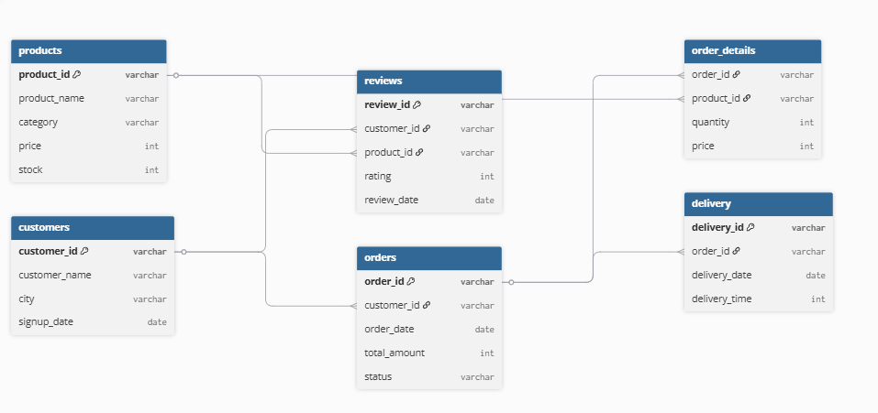
DATABASE SCHEMA OVERVIEW
(Entity-relationship Diagram OF Blinkit Sales)

Slide 4

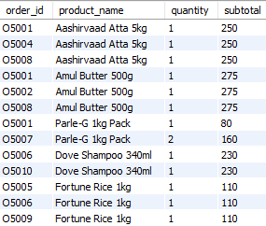
Show product name, quantity, and subtotal for each order.
Outcome :-

Slide 5
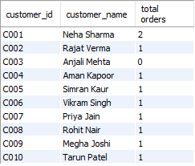
Find the total number of orders placed by each customer.
Outcome :-

Slide 6

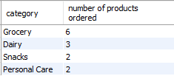
List the number of products ordered in each category.
Outcome :-

Slide 7


Show customers who have never placed an order.
Outcome :-

Slide 8

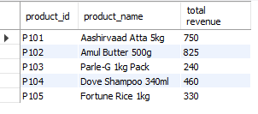
Get the total revenue generated from each product.
Outcome :-

Slide 9


Find customers who placed more than 1 order.
Outcome :-

Slide 10

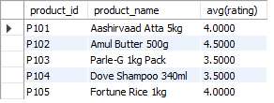
Show the average rating received by each product.
Outcome :-

Slide 11


List customers who have placed the highest total order amount.
Outcome :-

Slide 12

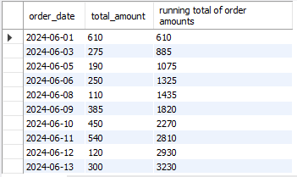
Show running total of order amounts by date.
Outcome :-

Slide 13
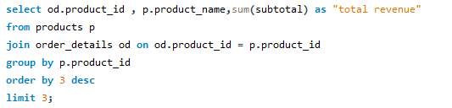

Show top 3 products by total revenue using window functions.
Outcome :-

Slide 14

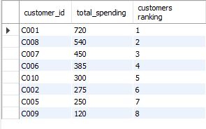
List the number of products ordered in each category.
Outcome :-

Slide 15

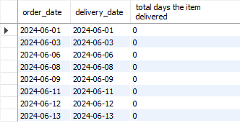
Count how many days it took to deliver each order.
Outcome :-

Slide 16
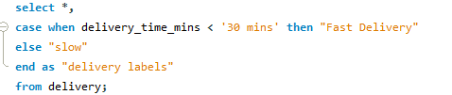
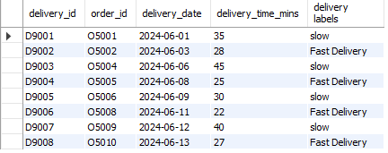
Use CASE to label orders as “Fast Delivery” if delivery time < 30 mins, else “Slow”.
Outcome :-

